Slide 1
Dominion AI using Monte carlo tree search (mcts)
Jonathan Sarasua

Slide 2

Overview
Introduction
Previous Work
Dominion
Monte Carlo Tree Search
Results
Artifact Demo
Implementation
Future Work
Conclusion

Slide 3
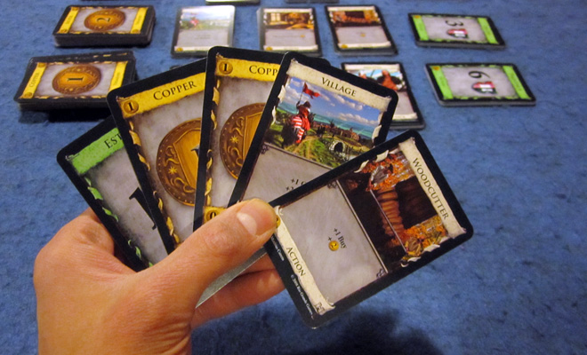
Introduction
Why Dominion?
Why MCTS?
Notes:
Here I’ll talk about my interest in boardgames and how I came to choose MCTS. I’ll mention I had no prior experience with AI, so MCTS made sense since the concept is simple but still pops up in conjunction with other AIs like Alpha Zero and Hierarchical Portfolio Search

Slide 4
Overview
Introduction
Previous Work
Dominion
Monte Carlo Tree Search
Results
Artifact Demo
Implementation
Future Work
Conclusion

Slide 5
Previous work
MCTS with other AIs
AlphaZero [5]
Google’s AI to play Chess, Shogi, and Go
Hierarchical Portfolio Search (HPS) [4]
MCTS with Dominion
Jansen and Tollisen [1]
Used simple set of cards
~68% winrate against common state machine AIs like Single Witch

Slide 6
Overview
Introduction
Previous Work
Dominion
Monte Carlo Tree Search
Results
Artifact Demo
Implementation
Future Work
Conclusion

Slide 7

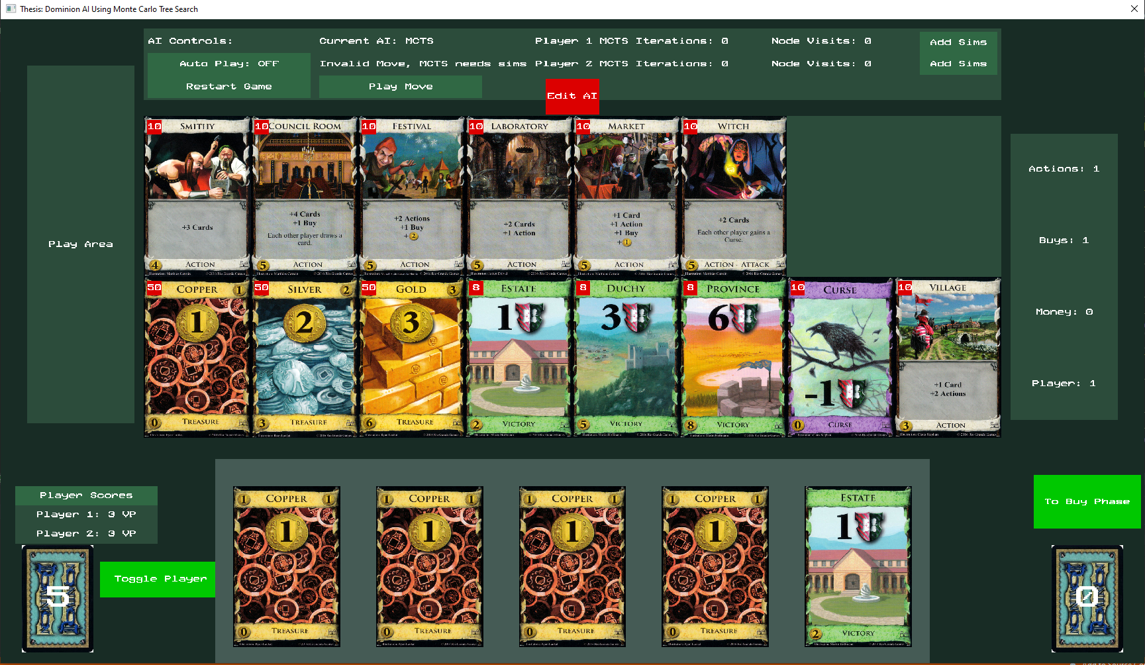
Notes:
Here I’ll talk about the basic rules of Dominion

Slide 8
Card count
Card piles
Card Count
Notes:
Here I’ll talk about the basic rules of Dominion

Slide 9
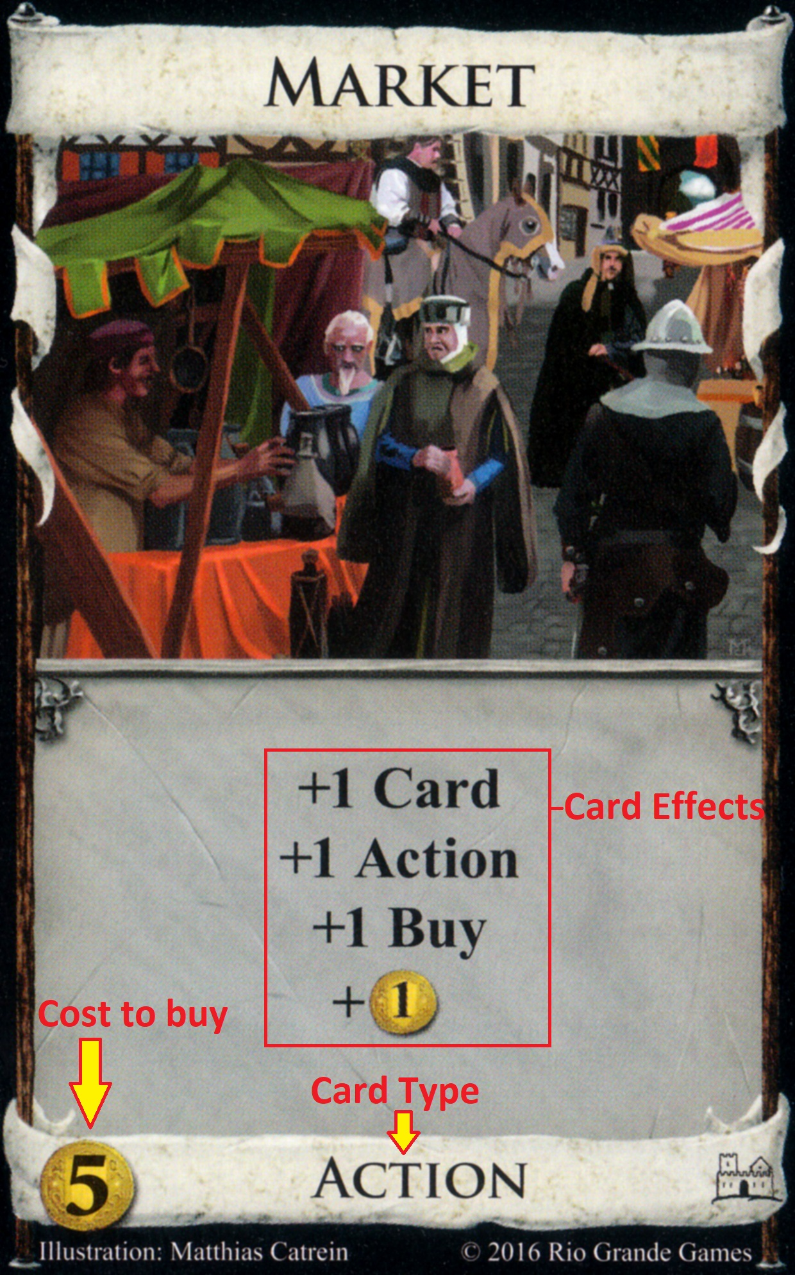
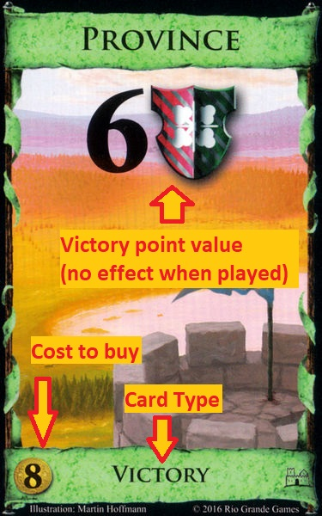
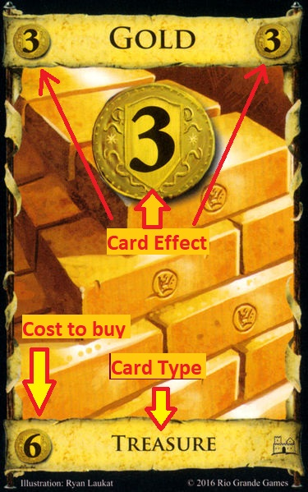

Slide 10
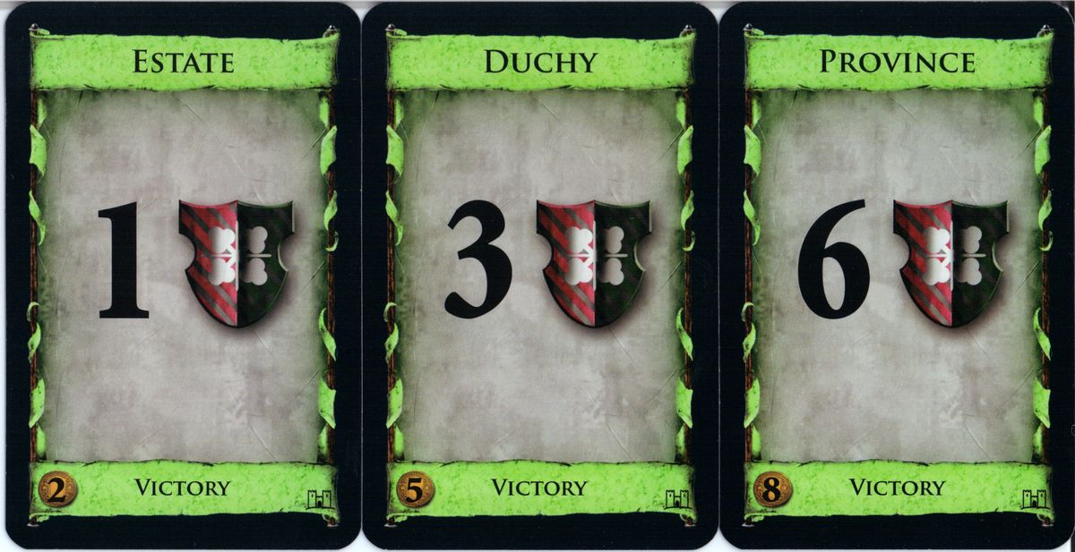
Dominion
How to win:
Have more victory points from Green cards
Game ends when:
3 of the piles are exhausted OR
Province pile is exhausted

Slide 11
Dominion
Start of game
Shuffle starting deck
Draw 5 cards
Each turn
Play one action (grey cards)
Buy one card
Put Bought card in discard pile
End Turn
Discard all cards in hand, play area, and what you bought
Draw 5 new cards
If deck is empty, shuffle discard pile and make your deck
Cannot play action after buying
Notes:
Here I’ll talk about the basic rules of Dominion

Slide 12
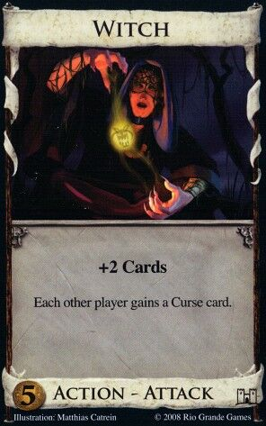
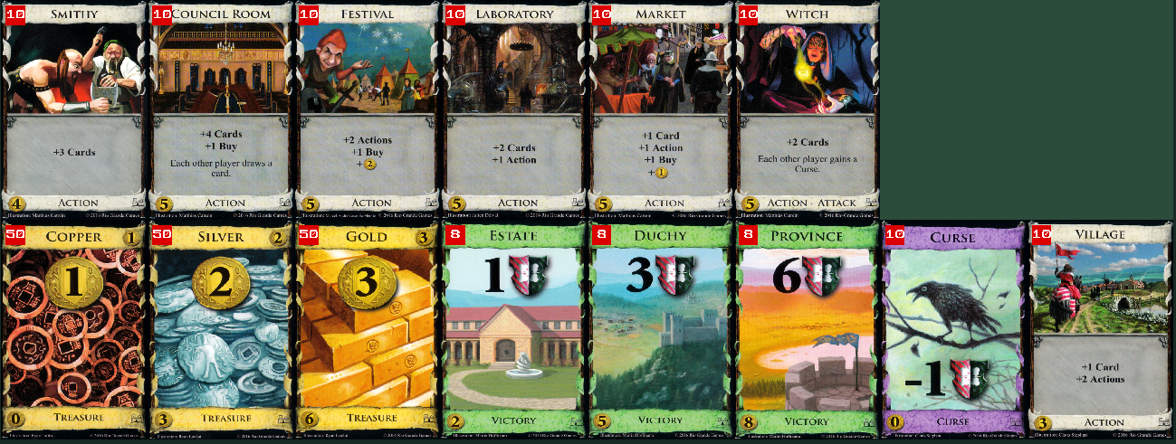
Single State machine test bed
Big Money
Baseline
Single Witch
Double Witch
Sarasua1
Notes:
Here I’ll talk about Dominion strategy theory and explain these state machines

Slide 13
Overview
Introduction
Previous Work
Dominion
Monte Carlo Tree Search
Results
Artifact Demo
Implementation
Future Work
Conclusion

Slide 14
MCTS Background
Goal:
Able to always have a result in a limited timeframe
Get smarter the more time it has
Solution:
Build tree of all game states
Save metadata to nodes in the tree while building to allow giving an answer while incomplete
Build where the most promising moves are
Nice to have
Keep the solution general enough that expert knowledge isn’t required
Combine with other AIs to make a better AI

Slide 15
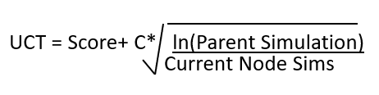
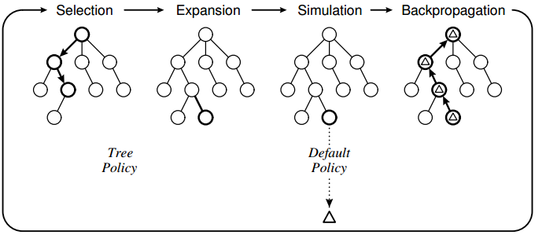
MCTS
UCT
Score = winrate
C = Exploration parameter
Build the best incomplete tree of game states
Selection
Can expand current node?
Uses Upper Confidence Bounds Applied To Trees (UCT) to select the best node to expand
Expansion
Add unexplored child node to selected node
Simulation
Plays a game using random moves and returns 0, 0.5, or 1 for loss, tie, or win
Backpropagation
Take the result from simulation and backpropagate relative to the current player
[2]
Notes:
Here I’ll talk about the basic theory of Pure MCTS

Slide 16
MCTS
UCT
Score = winrate
C = Exploration parameter
Best move is
Highest winrate move
Most visited move
[2]
Notes:
Here I’ll talk about the basic theory of Pure MCTS

Slide 17
MCTS in a card game
23/45
Each move may have multiple outcomes
Input Move
Input Move
14/27
Wins / Simulations
Input Move
Input Move
Player 1
Player 2
3/5
2/7
4/6
1/3
1/2
2/3

Slide 18
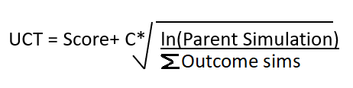
MCTS in a card game
UCT formula changes
Comparing moves instead of single outcome
Score = ∑Wins/∑Simulations

Slide 19
MCTS in a card game
23/45
During Selection how do we choose which outcome from the move chosen by UCT?
Sampling?
Possible place for bugs
Ask the game to play the given move
Randomize unknown info
Deck order
Opponent’s hand and deck
Input Move
Input Move
14/27
Input Move
Input Move
3/5
2/7
4/6
1/3
1/2
2/3

Slide 20
Example
Action Phase Options
Play Village
Play Woodcutter
Go To Buy Phase

Slide 21
Steps
Select
Expand
Rollout
Backpropagate
Gamestate
Hand: Estate, Copper, Copper, Vilage, Woodcutter
MetaData
2 Win
3 Simulations
Node
Play Village
End Action Phase
Select step
Can Expand?
Play Woodcutter
Yes
+Copper
+2 Actions
+2 Coins
+1 Buy
MetaData
1 Win
1 Simulation
MetaData
1 Win
1 Simulation

Slide 22
Steps
Select
Expand
Rollout
Backpropagate
Gamestate
Hand: Estate, Copper, Copper, Vilage, Woodcutter
MetaData
2 Win
3 Simulations
Node
Play Village
End Action Phase
Expand step
Add Node
Play Woodcutter
+Copper
+2 Action
+2 Coins
+1 Buy
Buy Phase
MetaData
0 Win
0 Simulation

Slide 23
Steps
Select
Expand
Rollout
Backpropagate
Gamestate
Hand: Estate, Copper, Copper, Vilage, Woodcutter
MetaData
2 Win
3 Simulations
Node
Play Village
End Action Phase
Rollout step
Run simulation
Record result
Play Woodcutter
+Copper
+2 Action
+2 Coins
+1 Buy
Buy Phase
MetaData
0 Win
1 Simulation

Slide 24
Steps
Select
Expand
Rollout
Backpropagate
Gamestate
Hand: Estate, Copper, Copper, Vilage, Woodcutter
MetaData
2 Win
4 Simulations
Node
Play Village
End Action Phase
Backpropagation Step
pass result to parent
Play Woodcutter
+Copper
+2 Action
+2 Coins
+1 Buy
Buy Phase
MetaData
0 Win
1 Simulation

Slide 25
Steps
Select
Expand
Rollout
Backpropagate
Gamestate
Hand: Estate, Copper, Copper, Vilage, Woodcutter
MetaData
2 Win
4 Simulations
Node
Select step
Can Expand?
Play Village
End Action Phase
Play Woodcutter
No
Get Best Child
Move
+Estate
+2 Action
+Copper
+2 Action
+2 Coins
+1 Buy
Buy Phase
MetaData
1 Win
1 Simulation
MetaData
1 Win
1 Simulation
MetaData
0 Win
1 Simulation
New Outcome
Notes:
Look at brute force backtracking

Slide 26
Steps
Select
Expand
Rollout
Backpropagate
Gamestate
Hand: Estate, Copper, Copper, Vilage, Woodcutter
MetaData
2 Win
4 Simulations
Node
Play Village
End Action Phase
Expand new outcome
Play Woodcutter
+Copper
+2 Action
+Estate
+2 Action
+2 Coins
+1 Buy
Buy Phase
MetaData
1 Win
1 Simulation
MetaData
1 Win
1 Simulation
MetaData
0 Win
1 Simulation

Slide 27
Steps
Select
Expand
Rollout
Backpropagate
Gamestate
Hand: Estate, Copper, Copper, Vilage, Woodcutter
MetaData
2 Win
4 Simulations
Node
Play Village
End Action Phase
Expand new outcome
Run simulation
Play Woodcutter
+Copper
+2 Action
+Estate
+2 Action
+2 Coins
+1 Buy
Buy Phase
MetaData
1 Win
1 Simulation
MetaData
0 Win
1 Simulation
MetaData
1 Win
1 Simulation
MetaData
0 Win
1 Simulation

Slide 28
Steps
Select
Expand
Rollout
Backpropagate
Gamestate
Hand: Estate, Copper, Copper, Vilage, Woodcutter
MetaData
2 Win
5 Simulations
Node
Play Village
End Action Phase
Expand new outcome
Run simulation
Backpropagate up tree
Play Woodcutter
+Copper
+2 Action
+Estate
+2 Action
+2 Coins
+1 Buy
Buy Phase
MetaData
1 Win
1 Simulation
MetaData
0 Win
1 Simulation
MetaData
1 Win
1 Simulation
MetaData
0 Win
1 Simulation

Slide 29
Steps
Select
Expand
Rollout
Backpropagate
Gamestate
Hand: Estate, Copper, Copper, Vilage, Woodcutter
MetaData
2 Win
6 Simulations
MetaData
2 Win
5 Simulations
Node
Select
Can Expand?
No
Choose Best Child
Play Woodcutter
Can Expand?
Yes
Expand
Add End Action Move
Rollout
Lost, update Metadata
Backpropagate
Add sim and loss to
parent nodes
Play Village
End Action Phase
Play Woodcutter
+Copper
+2 Action
+Estate
+2 Action
+2 Coins
+1 Buy
Buy Phase
End Action Phase
MetaData
1 Win
1 Simulation
MetaData
1 Win
2 Simulation
MetaData
0 Win
1 Simulation
Buy Phase

Slide 30
Overview
Introduction
Previous Work
Dominion
Monte Carlo Tree Search
Results
Artifact Demo
Implementation
Future Work
Conclusion

Slide 31
Test bed results
 | Big Money | Games Played | Win%
Random | 200 | 200 | 100%
Single Witch | 4 | 200 | 2%
Double Witch | 14 | 200 | 7%
Sarasua1 | 4 | 200 | 2%
 | Double Witch | Games Played | Win%
Random | 200 | 200 | 100%
Big Money | 186 | 200 | 93%
Single Witch | 149.5 | 200 | 74.75%
Sarasua1 | 74 | 200 | 37%

Slide 32
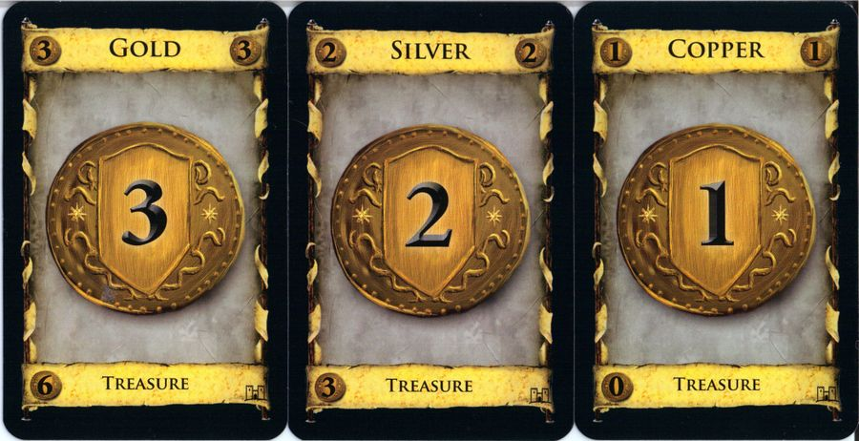
Results
Random rollouts
Run for a few thousand iterations
Lose every game against Big Money
Check for bugs?

Slide 33
Results with Base MCTS
Test in optimal situation
Opponent Big Money
100,000 iterations per move
20 games
10 as player 1 and 10 as player 2
Won 4
20% winrate
17 GB of RAM used by end of game
Averaged 42 minutes per game
Normal average game length is 30 minutes

Slide 34
How to tweak mcts
Selection
Change exploration parameter (C) in Upper confidence Bounds Applied to Trees
Theoretical value of C is √2 [3]
[2]

Slide 35
How to tweak mcts
Selection
Change exploration parameter (C) in Upper confidence Bounds Applied to Trees
Theoretical value of C is √2 [3]
C Value | C=√2 | Games played | Win %
C=0.5 | 10.5 | 20 | 52.5%
C=5 | 11 | 20 | 55%

Slide 36
How to tweak mcts
Simulation step
Can use a heuristic to simulate
[2]

Slide 37
How to tweak mcts
Simulation step
Can use a heuristic to simulate
Big Money
MCTS Using Big Money | 1,000 iterations per move | Games played | Win %
Big Money | 85 | 200 | 42.5%
MCTS Using Big Money | 10,000 iterations per move | Games played | Win %
Big Money | 162 | 200 | 81%

Slide 38
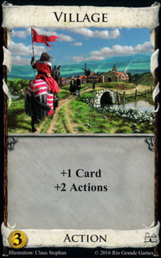
How to tweak mcts
Simulation step
Can use optimized random
RandomPLUS
During action phase, play cards that give extra actions first
Prioritize doing something over do nothing
MCTS AI | 100k Iterations w/Random | Games Played | Win%
Big Money | 4 | 20 | 20%
MCTS AI | 20k iterations w/ RandomPLUS | Games Played | Win%
Big Money | 61.5 | 100 | 61.5%

Slide 39
How to tweak mcts
Simulation step
Can use a heuristic to simulate
RandomPLUS
Big Money
Greedy
Buy most expensive card
Sarasua1
 | MCTS 10,000 iterations w/ Greedy | Games Played | Win%
Big Money | 93 | 100 | 93%
Double Witch | 56 | 100 | 56%
MCTS 10k w/ RandomPLUS | 29 | 50 | 58%
MCTS 10k w/ Sarasua1 | 25 | 50 | 50%

Slide 40
How to tweak mcts
Expansion step
Can expand only good moves
Use heuristics
Buy most expensive Victory
Buy most expensive Treasure
Buy most expensive Action
[2]

Slide 41
How to tweak mcts
Expansion step
Can expand only good moves
Use heuristics
Buy most expensive Victory
Buy most expensive Treasure
Buy most expensive Action
MCTS 10,000 iterations | RandomPLUS Heuristics | Games Played | Win%
All Moves | 29 | 50 | 58%
MCTS 10,000 iterations | Sarasua1 Heuristics | Games Played | Win%
All Moves | 37.5 | 50 | 75%

Slide 42
How to tweak mcts
Simulation step
Can use a heuristic to simulate
Can use heuristic but sometimes choose random (chaos chance)
MCTS 10k w/Sarasua1 using Heuristics | 0% Chaos Chance | Games Played | Win%
5% | 18.5 | 50 | 37%
10% | 19 | 50 | 38%
15% | 23 | 50 | 46%

Slide 43
Results
Everything
20,000 iterations per move
Expanding using Heuristics
Using 5% chaos chance
 | MCTS w/ Greedy | Games Played | Win%
Vs Double Witch | 13 | 20 | 65%
Vs Sarasua1 | 3 | 20 | 15%
 | MCTS w/ Saraua1 | Games Played | Win%
Vs Double Witch | 13.5 | 20 | 67.5%
Vs Sarasua1 | 8 | 20 | 40%

Slide 44
Other tweaks
Selection
Add a victory point nudge to handle any move winning/losing
[2]

Slide 45
Other Results
10,000 iterations per move
Time
3-5 minutes per game per MCTS
Space
1.5-2.5 GB RAM per game per MCTS

Slide 46
Overview
Introduction
Previous Work
Dominion
Monte Carlo Tree Search
Results
Artifact Demo
Implementation
Future Work
Conclusion

Slide 47
Overview
Introduction
Previous Work
Dominion
Monte Carlo Tree Search
Results
Artifact Demo
Implementation
Future Work
Conclusion

Slide 48
Data structure
Node
Moves
Parent Pointer
Move
Data
Possible outcomes for move
Data
Metadata
Metadata
Wins
Simulations
Gamestate

Slide 49
Implementation
Selection
How to calculate score?
Sum all possible outcomes for each move
Add VP Nudge
Expand
Don’t include duplicates
Expand over all possible moves
Expand over subset of moves
Subset gathered using heuristics
Buy Highest VP card
Buy highest Money Card,
Buy highest action card
Node
Moves
Parent Pointer
Data
Data
Metadata
Metadata
Wins
Simulations
Gamestate

Slide 50
Implementation cont’d
Best Move is selected from options
Ask Game for gamestate after playing move
Compare gamestate to stored gamestates
If exists, navigate through stored node
Else expand the current node with this new gamestate
Node
Game
Moves
Best move
Parent Pointer
Data
Gamestate
New Gamestate

Slide 51
Implementation cont’d
Simulation
Take a gamestate
Randomize unknown info
Play game using heuristics
Random, RandomPLUS
Big Money, Single/Double Witch
Greedy/Sarasua1
Chaos Chance
Chance to forgo heuristic and still play random move
Backpropagation
Take result and backpropagate
Keep relative to player of move

Slide 52
Threads
Spin off thread to do selection and expansion
Spin up five more threads for simulations
Original thread handles backpropagation
Simulation Threads
MCTS Thread
Application Thread

Slide 53
Threads
Possible problems
MCTS thread out of sync with the simulation jobs
Expanded nodes with no meta data
Simulation Threads
MCTS Thread
Application Thread

Slide 54
Saving and loading
Binary format
Total number of iterations to run
Number of iterations already run
Save Node
Save Data
Save Move Count
First Move Input
Save Child Node Count
Save Child Node
Node
Parent Pointer
Moves
Data
Child Nodes
Data
Metadata
Gamestate

Slide 55
Overview
Introduction
Previous Work
Dominion
Monte Carlo Tree Search
Results
Artifact Demo
Implementation
Future Work
Conclusion

Slide 56
Future Work
More testing
Change Move architecture
Buy Card and End Turn move
Buy Card Move then End Turn Move
Try more advanced rollout methods
Genetic Algorithm
Markov Chains
Add more cards
Implement MCTS on a different deckbuilding game

Slide 57
Overview
Introduction
Previous Work
Dominion
Monte Carlo Tree Search
Results
Artifact Demo
Implementation
Future Work
Conclusion

Slide 58
Conclusion
MCTS needs assistance
Best in combination with other AI/Expert knowledge

Slide 59
Bibliography
[1] J. V. Jansen and R. Tollisen, "An AI for Dominion Based on Monte-Carlo Methods," 2 June 2014. [Online]. Available: https://pdfs.semanticscholar.org/28b6/ada13e948cfaee4af5138ee667d404eb01ac.pdf. [Accessed 9 July 2020].
[2] "Monte Carlo Tree Search: Implementation for Tic-Tac-Toe," Stack Overflow, 22 April 2014. [Online]. Available: https://stackoverflow.com/questions/23803186/monte-carlo-tree-search-implementation-for-tic-tac-toe. [Accessed 9 February 2021].
[3] L. Kocsis and C. Szepesvári, "Bandit Based Monte-Carlo Planning," in Machine Learning: ECML, 2006.
[4] "Hierarchical Portfolio Search: Prismata's Robust AI Architecture for Games with Large Search Spaces," [Online]. Available: http://www.cs.mun.ca/~dchurchill/pdf/aiide15_churchill_prismata.pdf. [Accessed 20 4 2021].
[5] D. Silver, T. Hubert, J. Schrittwieser and D. Hassabis, "AlphaZero: Shedding new light on chess, shogi, and Go," 6 12 2018. [Online]. Available: https://deepmind.com/blog/article/alphazero-shedding-new-light-grand-games-chess-shogi-and-go. [Accessed 20 4 2021].

Slide 60
Questions?

